Slide 1
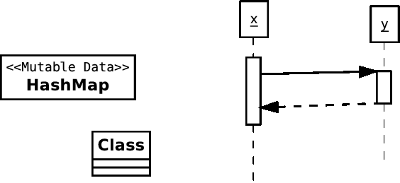
Are you in the right room?
Course: SE450 (Object-Oriented Software Development)
Instructor: Jeffrey Sharpe

Slide 2
Overview of today’s class
Introductions
Syllabus
Overview of the course/Administrative information
Objects, classes and their representation in the UML.
Functions
Static classes
Object classes
Relations between classes
Object class taxonomy
Data classes
Builder classes
Collection classes
Writing tests
Homework 1

Slide 3
Syllabus

Slide 4
A brief introduction
What is this course about?
Programming in the large.
Programming in the small: client is end-user.
Programming in the large: client is another programmer.
With maintenance, addition of functionality, you may be a client for yourself.
Ever look at code you wrote a year ago?
Producer/Consumer relation may be cyclic.
This course teaches management of the producer/consumer relationship, emphasizing code structure.

Slide 5
Development approach
We advocate an “extreme” style:
Develop functionality incrementally.
Start small.
Make sure you have beautiful code that works before you add any new functionality.
Think before you code (but not too much).
Design in small pieces -- don't do everything at once.
Accept that the design will change.
Write good tests.
Don't test you program by running it. Use automatic tests!
If the tests pass, you should be pretty sure you coded correctly.
Write good code.
First, write the simplest code possible.
Get it to work (pass the tests).
Last, improve the code by refactoring: improve structure without changing functionality.
Iterate.
Once you get something beautiful that works, begin to design the next piece of functionality.

Slide 6
Java Self Assessment
Do the following:
Develop a linked list class.
Code it from scratch.
Support the usual operations on a list such as insertion and deletion.
Support a toString method that returns the contents of the list as a string.
Develop a class hierarchy of shapes.
Shapes include: Shape Closed Shape Circle, Rectangle, ... Open Shape Line, Curve, ... Text
Each class supports a method toString that returns the attributes of the shape as a string.
Instantiate a list of shapes. Insert several different shapes into the list, and print out the contents of
the list of shapes.
If you have:
no difficulty --- fine
some difficulty --- make sure you have lots of time to devote to this class
major difficulty --- you will find this class extremely difficult

Slide 7
How to talk about code via email or d2l
If you want advice about an error, post to D2L, doing one of the following:
Include a screenshot showing the error.
Copy and paste the EXACT TEXT of the error into your message.
Include the code that caused the error, with enough context to understand it
Make sure that you clearly indicate the line with the error.
If you have a problem getting a program to work and you want your code looked at in more detail, post to D2L with the following three things:
Your java file as an attachment.
A description of how the output of the program is different from what you expected.
The output of your program, if it runs.
Include in the screenshot, or
Copy and paste from the eclipse console

Slide 8
Final project
This course requires that you complete a project.
The project must be your work alone.
Project work begins week before the midterm.
More details on the project forthcoming.

Slide 9
Contact Information
My coordinates:
I work near Monroe and Wells
Contact by phone:
Don’t.
Email:
jsharpe1@cdm.depaul.edu
Typically respond within 24 hours (and typically within a few hours)
Sometimes will take me longer depending on email content

Slide 10
Office Hours
Let me know if you will be coming to office hours!!!
If you can’t make office hours and need 1:1 help, I will try to make arrangements during lunch or after work.

Slide 11
Tools
Life is much better with tools.
The big four:
Program editor. For example, NetBeans or Eclipse.
Automated build tool. For example, ant or make.
Automated testing tool. For example, junit or related xunit tools.
Versioning system. For example, GIT or TFS.
See here for notes on installing eclipse and related tools.

Slide 12
Subclassing
We will discuss subclassing after the midterm.
For now, all classes we write will be direct subclasses of java.lang.Object

Slide 13
How do we run a program?
Several logical steps
Compile -- may compile pieces of program separately, creating multiple object files and "libraries" or "archives" ("jar" file)
(Static linking and initialization)
Load program into memory
Dynamic linking and initialization
Run
The first two steps are static -- happen at compile time.
The last three steps are dynamic -- happen at runtime.

Slide 14
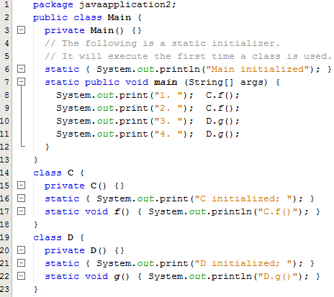
Class Initialization
Java loads and initializes classes dynamically.
General rule: (load and) initialize class when first needed.
Notes:
public class Main {
private Main() {}
// The following is a static initializer.
// It will execute the first time a class is used.
static { System.out.println("Main initialized"); }
static public void main (String[] args) {
System.out.print("1. "); C.f();
System.out.print("2. "); C.f();
System.out.print("3. "); D.g();
System.out.print("4. "); D.g();
}
}
class C {
private C() {}
static { System.out.print("C initialized; "); }
static void f() { System.out.println("C.f()"); }
}
class D {
private D() {}
static { System.out.print("D initialized; "); }
static void g() { System.out.println("D.g()"); }
}

Slide 15
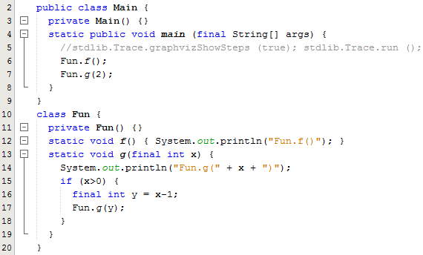
Functions
What is a function?
Notes:
public class Main {
private Main() {}
static public void main (final String[] args) {
//stdlib.Trace.graphvizShowSteps (true); stdlib.Trace.run ();
Fun.f();
Fun.g(2);
}
}
class Fun {
private Fun() {}
static void f() { System.out.println("Fun.f()"); }
static void g(final int x) {
System.out.println("Fun.g(" + x + ")");
if (x>0) {
final int y = x-1;
Fun.g(y);
}
}
}

Slide 16
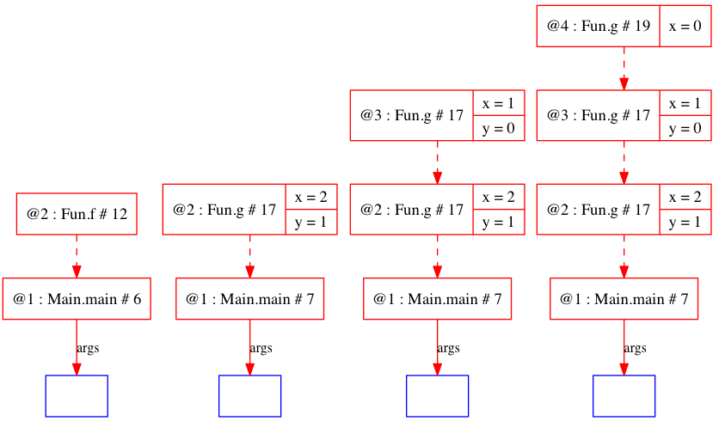
Functions
Here is a visualization of the execution at four different points in time

Slide 17
Activation
Each function call (or activation) creates an instance of the function variables (including parameters).
The variables are stored in an activation record instance (ARI).
The period from activation to return is the lifetime of the ARI.
Memory is allocated by the system at birth
Memory is returned to the system at death
We can draw ARI's, including an instance number to distinguish them.

Slide 18
Objects
What is an object?
Basic idea: an object is something that may respond to a message.
Further: an object may have state.
The state of the object may be used in generating a response to a message.
If an object is mutable, its response may vary over time.
Example: a printer queue.

Slide 19
Object-oriented?
Curious fact: in a java program, there is no direct way to describe an object.
Java is class-based.
Classes are described directly.
Objects are instances of classes.
Most OO-languages are class based -- descendants of simula and smalltalk.
Prototype-based languages work differently.

Slide 20
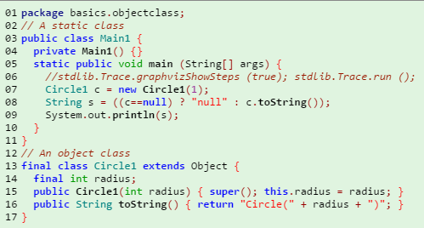
Object classes and static classes
Let's distinguish two types of classes:
object classes are instantiable -- they are templates for stamping objects
static classes are not instantiable -- they are collections of functions
Notes:
// A static class
public class Main1 {
private Main1() {}
static public void main (String[] args) {
//stdlib.Trace.graphvizShowSteps (true); stdlib.Trace.run ();
Circle1 c = new Circle1(1);
String s = ((c==null) ? "null" : c.toString());
System.out.println(s);
}
}
// An object class
final class Circle1 extends Object {
final int radius;
public Circle1(int radius) { super(); this.radius = radius; }
public String toString() { return "Circle(" + radius + ")"; }
}

Slide 21
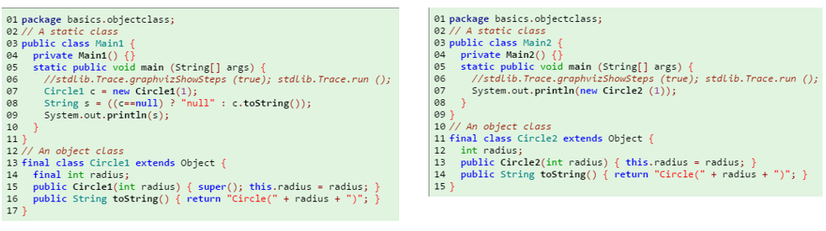
Object classes and static classes
Java allows some shorthand.
The following declarations are equivalent
Important: compilers add/remove local variables as they wish (that are not parameters). Some locals get mapped to addresses on the stack and some to registers.
Do not “optimize” local variables for performance!
Notes:
// A static class
public class Main2 {
private Main2() {}
static public void main (String[] args) {
//stdlib.Trace.graphvizShowSteps (true); stdlib.Trace.run ();
System.out.println(new Circle2 (1));
}
}
// An object class
final class Circle2 extends Object {
int radius;
public Circle2(int radius) { this.radius = radius; }
public String toString() { return "Circle(" + radius + ")"; }
}

Slide 22
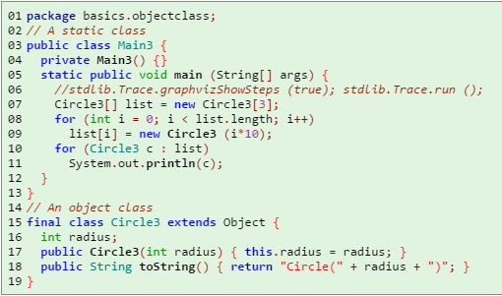
Constructors/methods/fields
Object classes have three kinds of members:
Constructors specify how to build objects inhabiting the class.
Methods specify how the object responds to messages.
Fields specify the state of the object.
Notes:
public class Main3 {
private Main3() {}
static public void main (String[] args) {
//stdlib.Trace.graphvizShowSteps (true); stdlib.Trace.run ();
Circle3[] list = new Circle3[3];
for (int i = 0; i < list.length; i++)
list[i] = new Circle3 (i*10);
for (Circle3 c : list)
System.out.println(c);
}
}
// An object class
final class Circle3 extends Object {
int radius;
public Circle3(int radius) { this.radius = radius; }
public String toString() { return "Circle(" + radius + ")"; }
}

Slide 23
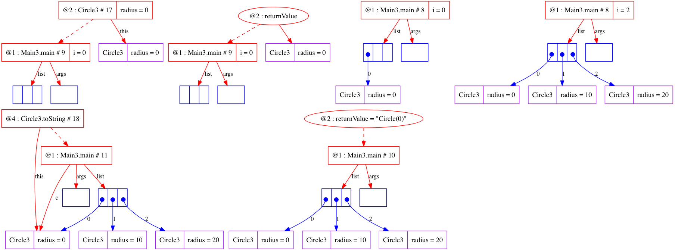
Constructors/methods/fields

Slide 24

Object diagrams
An object diagram is a snapshot of a running system, showing live objects.
Here are the ARIs when executing Circle.toString
Note the difference between the ARIs
The ARI for toString has a special variable, this, which identifies the object receiving the message
This is the main difference between a static method and a non-static method

Slide 25
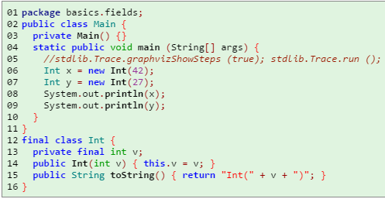
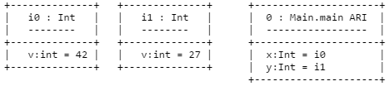
Fields
Fields can be used to distinguish different objects of a class
The object diagram at line 00008 is:
Notes:
public class Main {
private Main() {}
static public void main (String[] args) {
//stdlib.Trace.graphvizShowSteps (true); stdlib.Trace.run ();
Int x = new Int(42);
Int y = new Int(27);
System.out.println(x);
System.out.println(y);
}
}
final class Int {
private final int v;
public Int(int v) { this.v = v; }
public String toString() { return "Int(" + v + ")"; }
}

Slide 26

Fields
It is traditional in the UML to show objects, but not ARIs.
This can be confusing.
Although the names given to objects are arbitrary, perhaps the following are more helpful:

Slide 27
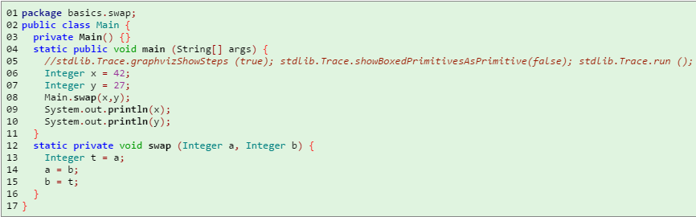
Passing parameters
What does the following print?
Notes:
public class Main {
private Main() {}
static public void main (String[] args) {
//stdlib.Trace.graphvizShowSteps (true); stdlib.Trace.showBoxedPrimitivesAsPrimitive(false); stdlib.Trace.run ();
Integer x = 42;
Integer y = 27;
Main.swap(x,y);
System.out.println(x);
System.out.println(y);
}
static private void swap (Integer a, Integer b) {
Integer t = a;
a = b;
b = t;
}
}

Slide 28
Passing parameters
This prints:
42
27
Java is call-by-value
Notes:
public class Main {
private Main() {}
static public void main (String[] args) {
//stdlib.Trace.graphvizShowSteps (true); stdlib.Trace.showBoxedPrimitivesAsPrimitive(false); stdlib.Trace.run ();
Integer x = 42;
Integer y = 27;
Main.swap(x,y);
System.out.println(x);
System.out.println(y);
}
static private void swap (Integer a, Integer b) {
Integer t = a;
a = b;
b = t;
}
}

Slide 29
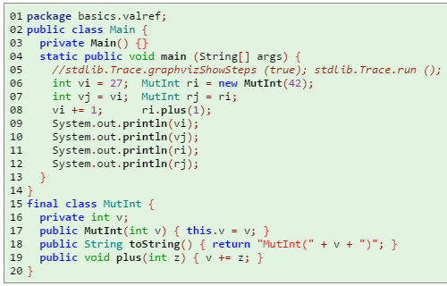
Values and references
Java has a reference model for objects. This is like C# and different from C++. In C# terminology, Java objects are boxed, whereas base values are unboxed.
What does the following print?
Notes:
public class Main {
private Main() {}
static public void main (String[] args) {
//stdlib.Trace.graphvizShowSteps (true); stdlib.Trace.run ();
int vi = 27; MutInt ri = new MutInt(42);
int vj = vi; MutInt rj = ri;
vi += 1; ri.plus(1);
System.out.println(vi);
System.out.println(vj);
System.out.println(ri);
System.out.println(rj);
}
}
final class MutInt {
private int v;
public MutInt(int v) { this.v = v; }
public String toString() { return "MutInt(" + v + ")"; }
public void plus(int z) { v += z; }
}

Slide 30
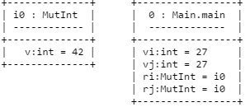
Values and references
Consider the object diagram after line 00007:
This phenomenon is called aliasing.
Note that aliasing occurs whenever an object is passed as an argument to a function.
Aliasing mutable values must be handled with care.

Slide 31
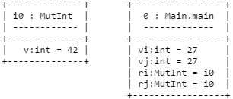

UML notation for references
In the UML, references are usually shown using arrows.
Instead of this:
We draw this:

Slide 32
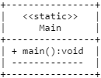
UML class diagrams: static class
A static class looks like this:
The class name is not underlined
Static methods are underlined
<<static>> is a stereotype
Method return type follows colon
May contain static fields, which are also underlined (none shown here)

Slide 33
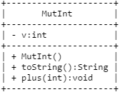
UML class diagrams: object class
An object class looks like this:
The class name is not underlined
Non-static methods are not underlined
Fields are listed first, methods second
- is private
+ is public
A static class describes the class itself.
An object class describes the instances of the class

Slide 34
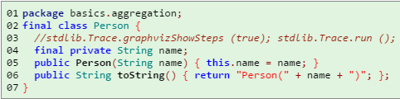

Aggregation
Reference to objects of another class:
In UML, this is called aggregation.
Note that the aggregation refers to the instances of the class, not the class itself.
Notes:
final class Person {
//stdlib.Trace.graphvizShowSteps (true); stdlib.Trace.run ();
final private String name;
public Person(String name) { this.name = name; }
public String toString() { return "Person(" + name + ")"; };
}

Slide 35
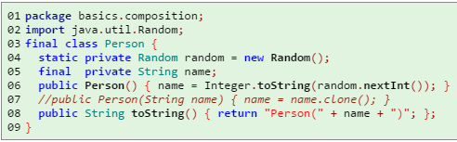

Composition
Exclusive reference to objects of another class:
In UML, this is called composition.
Consequences of composition:
When the person dies, the name dies too
Name can only be accessed through the person
Notes:
import java.util.Random;
final class Person {
static private Random random = new Random();
final private String name;
public Person() { name = Integer.toString(random.nextInt()); }
//public Person(String name) { name = name.clone(); }
public String toString() { return "Person(" + name + ")"; };
}

Slide 36
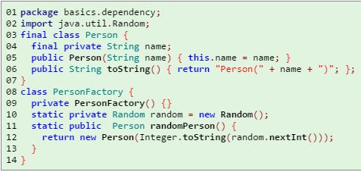

Dependency
This dependency indicates that PersonFactory mentions Person, but holds no references to Person objects
Typical reasons for a dependency*:
Person is returned by a method
Person is a parameter of a method
Person is held in a local variable but not a field
Notes:
* I disagree with this definition in part – still a dependency if it has a Concrete class as a field.
import java.util.Random;
final class Person {
final private String name;
public Person(String name) { this.name = name; }
public String toString() { return "Person(" + name + ")"; };
}
class PersonFactory {
private PersonFactory() {}
static private Random random = new Random();
static public Person randomPerson() {
return new Person(Integer.toString(random.nextInt()));
}
}

Slide 37
The ugly truth
The dichotomy between static-class and object-class is not enforced in java.
Guideline: separate static and object functions into different classes
Example: java.lang.Math is a static class; java.util.Random is an object class.
Note: this guideline is often violated in the java APIs. For example: java.lang.String and all the wrapper classes, such as java.lang.Integer.

Slide 38
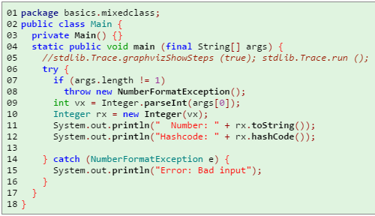
Mixed classes
It is useful to think of a mixed class in terms of its two functions:
Static members belong to the class, eg, Integer.MAX_VALUE:int and Integer.parseInt(String):int. Access these members using the class name.
Non-static members belong to the objects, eg, Integer.hashCode():int. Access these members using an object reference – this is the only way you can!
Notes:
public class Main {
private Main() {}
static public void main (final String[] args) {
//stdlib.Trace.graphvizShowSteps (true); stdlib.Trace.run ();
try {
if (args.length != 1)
throw new NumberFormatException();
int vx = Integer.parseInt(args[0]);
Integer rx = new Integer(vx);
System.out.println(" Number: " + rx.toString());
System.out.println("Hashcode: " + rx.hashCode());
} catch (NumberFormatException e) {
System.out.println("Error: Bad input");
}
}
}

Slide 39
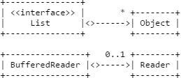
Multiplicity
Multiplicities put constraints on number of references held by an object
Recall java.util.List and java.io.BufferedReader.
Note: if multiplicity is 1, then reference must be non-null when constructor terminates.
This may require that we throw an IllegalArgumentException if an argument to the constructor is null

Slide 40
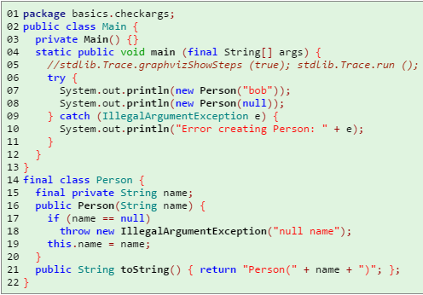

Multiplicity
Notes:
public class Main {
private Main() {}
static public void main (final String[] args) {
//stdlib.Trace.graphvizShowSteps (true); stdlib.Trace.run ();
try {
System.out.println(new Person("bob"));
System.out.println(new Person(null));
} catch (IllegalArgumentException e) {
System.out.println("Error creating Person: " + e);
}
}
}
final class Person {
final private String name;
public Person(String name) {
if (name == null)
throw new IllegalArgumentException("null name");
this.name = name;
}
public String toString() { return "Person(" + name + ")"; };
}

Slide 41
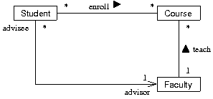
Association
The diagram describes the relationship of objects without reference to implementation.
The diagram uses associations which may be either dependencies or references.
Associations are more abstract (less specific, less concrete) than dependencies and references.
The diagram also show the use of roles and names in associations.
An association without an arrowhead may be bidirectional.

Slide 42
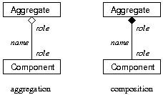
UML summary
Reference/Exclusive Reference:
Dependency (no reference):
Association (could be either reference or dependency):

Slide 43
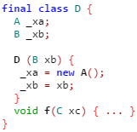
Test
Draw 2 UML diagrams for this code
Be as abstract as possible.
Be as concrete as possible.
Notes:
Abstract: Association
Concrete: Reference/exclusive reference UML, etc.

Slide 44
Testing overview
What is testing?
How Google Tests Software
What kinds of testing are there?
For us, the most important distinctions are:
Automatic/Manual
Unit/Acceptance

Slide 45
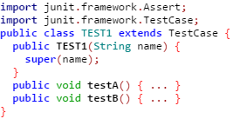
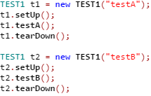
JUnit tests
Create a test class. (Test classes are object classes.)
Each test method is treated like a separate program.
Tests are run as: Arrange, Act, Assert:

Slide 46
JUnit tests
Each test has one of three possible outcomes:
pass: test ended normally and no assertion failed
fail: test ended normally at least one assertion failed
error: uncaught exception thrown before test ended
Rules for a test class:
class must be public
class name must include substring “TEST” (for ant)
class must extend junit.framework.TestCase
constructor must accept String parameter and pass it to constructor
non-static methods “public void test...()” are run automatically as tests

Slide 47

JUnit assertions
junit.framework.Assert is a static class
The basic assertion method is assertTrue which comes in two forms:
If the boolean value is false, then the enclosing test will fail
In the second form, the String is printed when the assertion is false
If there are multiple assertions in a single test, then the enclosing test fails if any assertion is false.

Slide 48
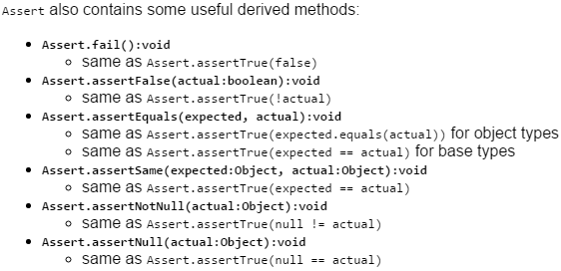
JUnit derived assertions
See the Junit API.

Slide 49
JUnit example
basics.testing.PairTEST
Notes:
http://fpl.cs.depaul.edu/jriely/450/notes/notes-tools-001.html

Slide 50
Why a taxonomy?
Taxonomy = classification
It is useful to think of classes in terms of how they are used.
We have already seen a basic taxonomy:
static class
object class
mixed class

Slide 51
Object classes
Much of this class is about giving names to various kinds of object classes:
Decorator classes
Observer classes
Visitor classes
...
We now consider three kinds of object class:
Data classes (immutable and mutable)
Builder classes
Collection classes

Slide 52
Immutable data classes
We already have seen a basic version: Person
Here is a more robust example: basics.immutabledata.Main

Slide 53
Guidelines for immutable classes
Make all fields final
Ensure that fields are correctly initialized by constructor
Override equals, hashCode, and toString
Follow the recipes in Bloch
Consider overriding compareTo
Follow the recipes in Bloch
An instance of an immutable data class is immutable if the objects passed into the constructor never change.

Slide 54

Guidelines for immutable classes
Which of these are immutable?
Notes:
Pair p1 = new Pair("dog", "cat");
StringBuilder b2 = new StringBuilder("dog");
Pair p2 = new Pair(b2, "cat");
b2.append("ma");
Pair p3 = new Pair(new StringBuilder("dog"), "cat");

Slide 55
Hashcode
Hashcode Links
Java Practices article
Apache HashCodeBuilder
Vipan Singla's comments on hashCode
Brian Goetz's comments on hashCode
Mark Roulo's comments on hashCode

Slide 56
Advantages of immutable objects
Immutable objects do not change.
Aliasing does not matter!
We can freely copy references without fear that the object will change.
This has several corollaries
No need to clone an immutable object
No need for an exclusive reference (defensive copy) of an immutable object.
Concurrency presents no difficulties -- see SE552
With extra care == and equals are equivalent -- discussed later
Guideline: make all data classes immutable

Slide 57
The builder pattern
Mutable data classes are useful for building objects incrementally.
This is called the builder pattern.
A builder is an object that is used to create an object of another class. Usually the builder is used to create exactly one other object, then discarded.
The important part of the following example is toPair, which converts the mutable class to the immutable companion class

Slide 58
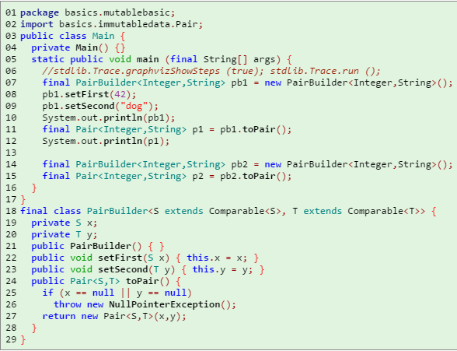
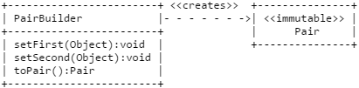
The builder pattern

Slide 59
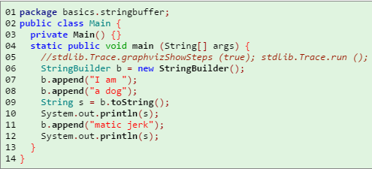

A builder in the java APIs
java.lang.StringBuilder is a builder for java.lang.String.
Here is an example, showing the usage:

Slide 60
Mutable data classes
Guidelines:
Always override toString
Consider overriding clone
Follow the recipies in Bloch.
Be careful with null references!
Be careful when overriding equals, hashCode, and comparesTo
hashCode should depend only on immutable attributes
If two objects are equals, they must have the same hashCode
compareTo should return 0 if and only if equals returns true

Slide 61
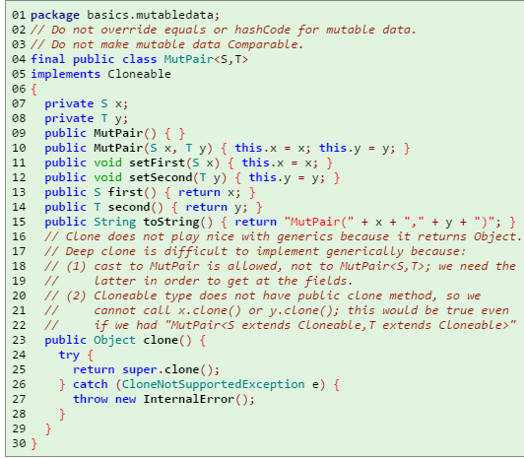
Mutable data classes
When dealing with mutable data objects, there are three choices:
leave equals/hashCode alone and do not override compareTo
make equals/hashCode/compareTo rely only on immutable data
use dangerous equals/hashCode and hope no-one uses the objects as keys in a hash table
In general, solution 1 is probably the best one. In homework 1, I chose option 2

Slide 62
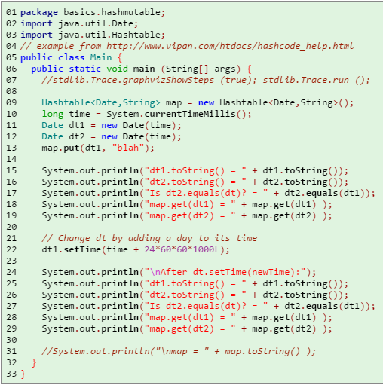
Hashing mutable data is dangerous!
It is possible to lose mutable values in a hashtable.
java.util.Date is mutable and overrides hashCode
Notes:
// dt2 pulls the value for dt1 because .equals is true
// after change, dt2 no longer .equals dt1. dt1 is still the key.
// hashtable checks .equals && .hashCode
import java.util.Date;
import java.util.Hashtable;
// example from http://www.vipan.com/htdocs/hashcode_help.html
public class Main {
public static void main (String[] args) {
//stdlib.Trace.graphvizShowSteps (true); stdlib.Trace.run ();
Hashtable<Date,String> map = new Hashtable<Date,String>();
long time = System.currentTimeMillis();
Date dt1 = new Date(time);
Date dt2 = new Date(time);
map.put(dt1, "blah");
System.out.println("dt1.toString() = " + dt1.toString());
System.out.println("dt2.toString() = " + dt2.toString());
System.out.println("Is dt2.equals(dt)? = " + dt2.equals(dt1));
System.out.println("map.get(dt1) = " + map.get(dt1) );
System.out.println("map.get(dt2) = " + map.get(dt2) );
// Change dt by adding a day to its time
dt1.setTime(time + 24*60*60*1000L);
System.out.println("\nAfter dt.setTime(newTime):");
System.out.println("dt1.toString() = " + dt1.toString());
System.out.println("dt2.toString() = " + dt2.toString());
System.out.println("Is dt2.equals(dt)? = " + dt2.equals(dt1));
System.out.println("map.get(dt1) = " + map.get(dt1) );
System.out.println("map.get(dt2) = " + map.get(dt2) );
//System.out.println("\nmap = " + map.toString() );
}
}

Slide 63
Collection classes
A collection may hold references to many other objects.
Usually the objects are of some uniform type, eg, a list of dogs, a set of colors
java.util provides several collection classes. (See the java tutorial.)
We may implement our own collections. Usually these make use of the java.util classes.

Slide 64
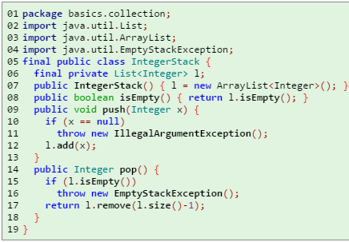
Collection classes
In the following example, IntegerStack delegates most of its responsibilities to List.
Notes:
import java.util.List;
import java.util.ArrayList;
import java.util.EmptyStackException;
final public class IntegerStack {
final private List<Integer> l;
public IntegerStack() { l = new ArrayList<Integer>(); }
public boolean isEmpty() { return l.isEmpty(); }
public void push(Integer x) {
if (x == null)
throw new IllegalArgumentException();
l.add(x);
}
public Integer pop() {
if (l.isEmpty())
throw new EmptyStackException();
return l.remove(l.size()-1);
}
}

Slide 65


UML representation of collections
Here is a good, abstract drawing:
Here is a drawing showing the implementation:
More concrete:
Too concrete:
This last diagram, while more technically correct, obscures the fact that IntegerStack is a collection of Integer

Slide 66
Homework 1
The basics.
Install eclipse and related tools by following the instructions here, here and here.
Download the homework files from D2L, as explained here.
Complete the files in the src directory correctly.
Upload the homework files to D2L, as explained here.
Evaluation.
Twenty points are available. Ten will be awarded for successful completion of VideoObj and InventorySet. Ten will be awarded for successful completion of the tests.
Zero points if your submitted zip file does not successfully compile using ant.
Five point maximum if any test ends in failure or error.
More detail.
Over the next few weeks we will develop a simple inventory control system for a video shop.
Your job this week is to complete the basic classes: an immutable data class and a collection.
I suggest you write VideoObj and VideoTEST first. Make sure all the tests are written and that they all pass.
Then write InventorySet and InventoryTEST. Get the tests to pass.
Note that there is no “main program''. Just tests!
You can view the source code online here [source]. (Private javadoc)
Notes:
https://d2l.depaul.edu/d2l/le/content/518305/viewContent/3528011/View

